Slide 1
SIGNALS AND SYSTEMS
IMAGE PROCESSING
AU2040264 Manan Vadaliya
AU2040080 Mohsinali Vijapura
AU2040014 Jay Patel

Slide 2
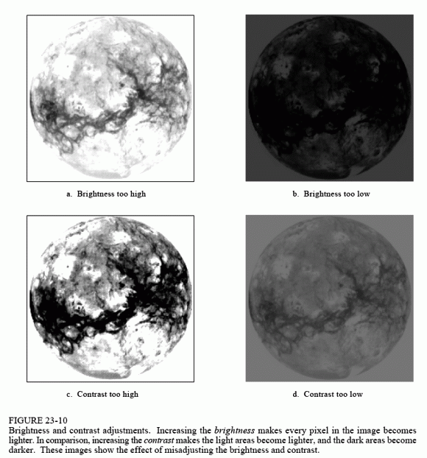
IMAGE PROCESSING
Advanced Image Processing implies handling digital picture through a digital PC. We can likewise say that it is a utilization of PC calculations, to get improved picture either to remove some helpful data.
Image processing mainly include the following steps:
1.Importing the image via image acquisition tools;
2.Analysing and manipulating the image;
3.Output in which result can be altered image or a report which is based on analysing that image.

Slide 3
TYPES OF IMAGES
Analogue and digital image processing are the two types of image processing technologies employed. Hard copies, such as prints and pictures, can benefit from analogue image processing. When employing these visual tools, image analysts employ a variety of interpretive foundations.
Digital image processing techniques allow for computer-assisted alteration of digital pictures. Pre-processing, augmentation, and presentation, as well as information extraction, are the three main processes that all sorts of data must go through when employing digital techniques.

Slide 4
DIGITAL IMAGE
The amplitude of F at any pair of coordinates (x,y) is termed the intensity of that picture at that place. An image is defined as a two-dimensional function, F(x,y), where x and y are spatial coordinates. A digital picture is one in which the x,y, and amplitude values of F are all finite.
To put it another way, a picture may be described as a two-dimensional array with rows and columns.
A digital image is made up of a limited number of elements, each of which has a specific value at a specific position.
Picture elements, image elements, and pixels are all terms used to describe these components.
A pixel is the most common unit of measurement for the components of a digital image.

Slide 5
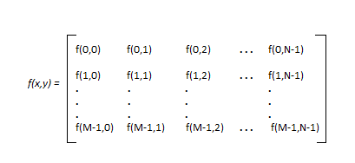
IMAGE REPRESENTATION AS A MATRIX
As we know, images are represented in rows and columns we have the following syntax in which images are represented:
The right side of this equation is digital image by defition. Every element of this matrix is called image element , picture element , or pixel.

Slide 6
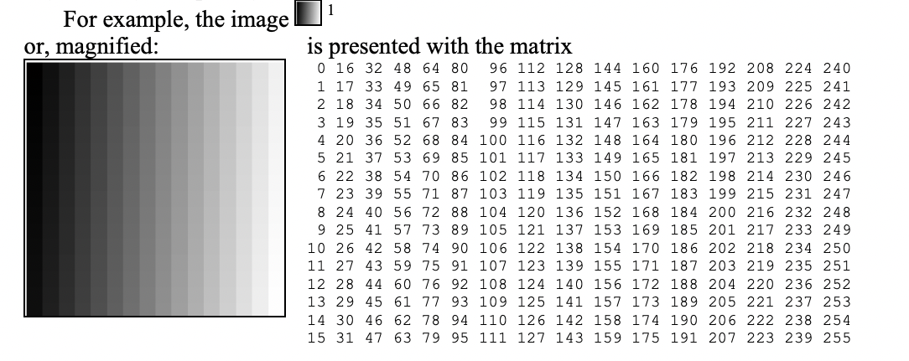
Image as a Matrix
The Matrix and its image Each image processing action performed by a computer may be viewed as an operation on an image matrix. Typically, the outcome of such an operation is a matrix of the original picture dimension (m x n), the members of which do not have to be from the range 0, 1,...., 255, but may alternatively be any real, or even complex numbers.

Slide 7
PHASES OF IMAGE PROCESSING
1.ACQUISITION– It could be as simple as being given an image which is in digital form. The main work involves:
a) Scaling
b) Color conversion(RGB to Gray or vice-versa)
2.IMAGE ENHANCEMENT– It is amongst the simplest and most appealing in areas of Image Processing it is also used to extract some hidden details from an image and is subjective.
3.IMAGE RESTORATION– It also deals with appealing of an image but it is objective(Restoration is based on mathematical or probabilistic model or image degradation).
4.COLOR IMAGE PROCESSING– It deals with pseudocolor and full color image processing color models are applicable to digital image processing.
5.WAVELETS AND MULTI-RESOLUTION PROCESSING– It is foundation of representing images in various degrees.

Slide 8
PHASES OF IMAGE PROCESSING
6.IMAGE COMPRESSION-It involves in developing some functions to perform this operation. It mainly deals with image size or resolution.
7.MORPHOLOGICAL PROCESSING-It deals with tools for extracting image components that are useful in the representation & description of shape.
8.SEGMENTATION PROCEDURE-It includes partitioning an image into its constituent parts or objects. Autonomous segmentation is the most difficult task in Image Processing.
9.REPRESENTATION & DESCRIPTION-It follows output of segmentation stage, choosing a representation is only the part of solution for transforming raw data into processed data.
10.OBJECT DETECTION AND RECOGNITION-It is a process that assigns a label to an object based on its descriptor.

Slide 9
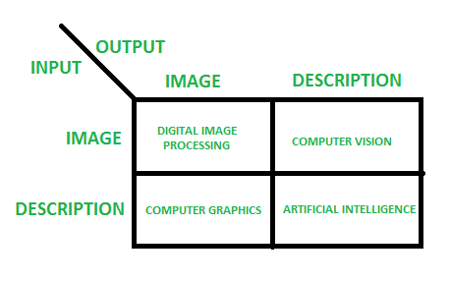
OVERLAPPING FIELDS WITH IMAGE PROCESSING
Digital Image Processing, according to block 1, is defined as follows: if the input is an image and the output is an image.
According to block 2, Computer Vision is defined as an input that is an image and an output that is some type of information or description.
Computer graphics, according to block 3, is defined as an input of some description or code and an output of an image.
According to block 4, if the input is a description, some keywords, or some code, and the output is a description or some keywords, it is called Artificial Intelligence.
``

Slide 10
SCILAB CODE FOR BRIGHTNESS ENHANCEMENT
Clc ;
Close;
// A = Imread ('D:\DIP\ Dog. GIF’);
//SIVP Tool Box(Signal Image And Video Processing Toolbox)
A = Imread (‘D: \DIP\Dog. Png ' );
A = Rgb2gray (A);
B = Double (A) +100;
B = Uint8 (B);
Figure (1)
ShowImage (B, ' Original Dog Image ‘);
Title ( ' Original Dog Image ' )
Figure (2)
ShowImage (Y, ' Enhanced Dog Image ‘);
Title ( ' Enhanced og Image ' )
//Scilab Code For Dilation And Erosion Process
Close ;
Clear ;
Clc ;
A= Imread ( 'D:\DIP\Morph. Bmp ' );
//SIVP Tool Box (Signal Image And Video Processing Toolbox)
//Y =[ 1 , 1 , 1 ; 1 , 1 , 1 ; 1 , 1 , 1 ] ;
Structure_Element = CreateStructure_Element ( ' Squa R E ' ,3) ;
X1 = DilateImage (A, Structure_Element );
X2 = ErodeImage (X, Structure_Element );
//Original Image Is Diplaying
// Imshow (A)
Figure (1)
ShowImage (A, ' Original Image ' );
//Ddilated Image Is Displaying
// Imshow ( A1 )
Figure (2)
ShowImage (A1 , ' Dilated Image ' );
Xtitle ( 'Dilated Image ' )
// Eroded Image Is Displaying
// Imshow ( A2 )
Figure (3)
ShowImage (A2 , ' Eroded Image ' );
Xtitle ( ' Eroded Image ' );

